Slide 1

Abortion

Slide 2







Summary of Project and Findings
Differences in the content, by newspaper outlets and gender of the authors
~6,500 articles scraped from CNN, Fox News, Federalist, Mother Jones, Vox, TIME, Zeit

Slide 3
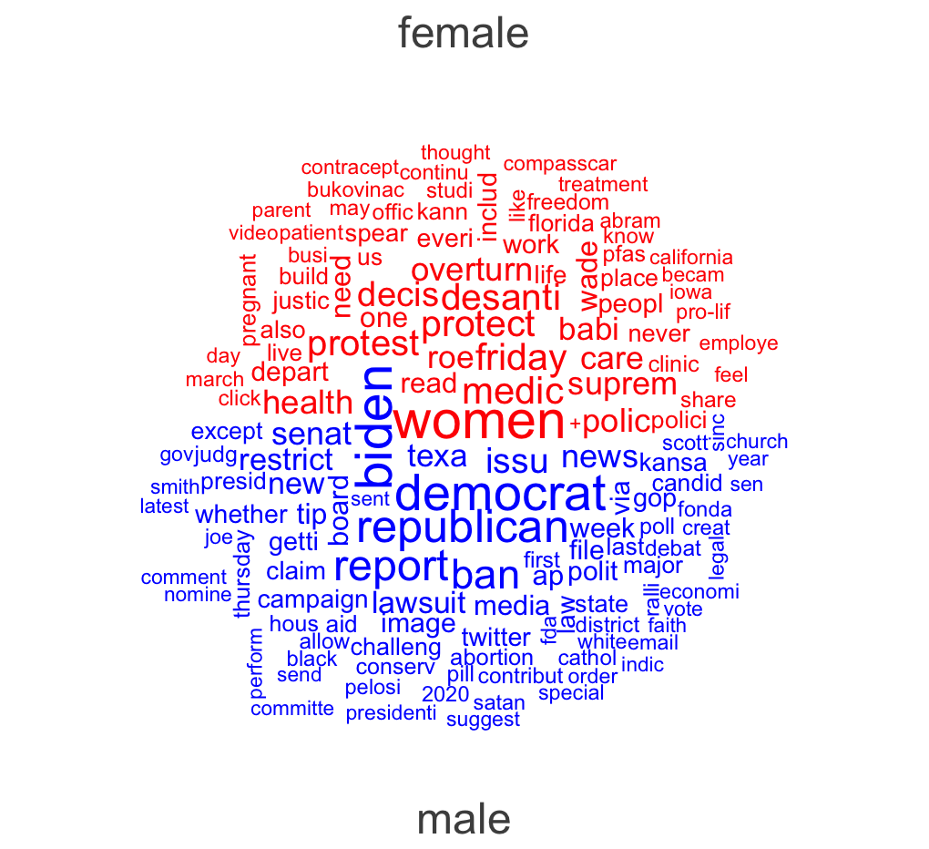
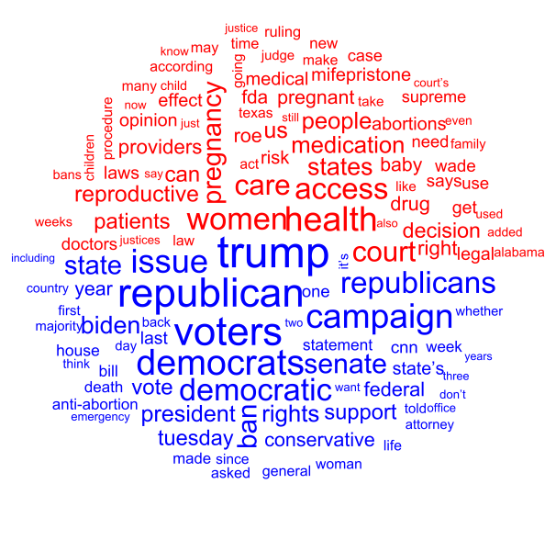
Results Wordclouds

Slide 4
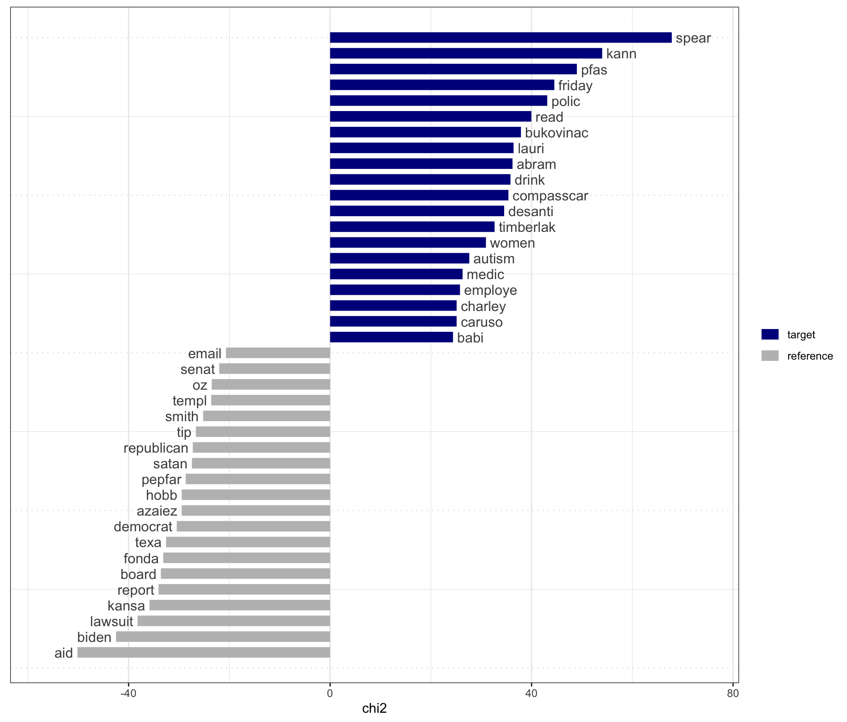
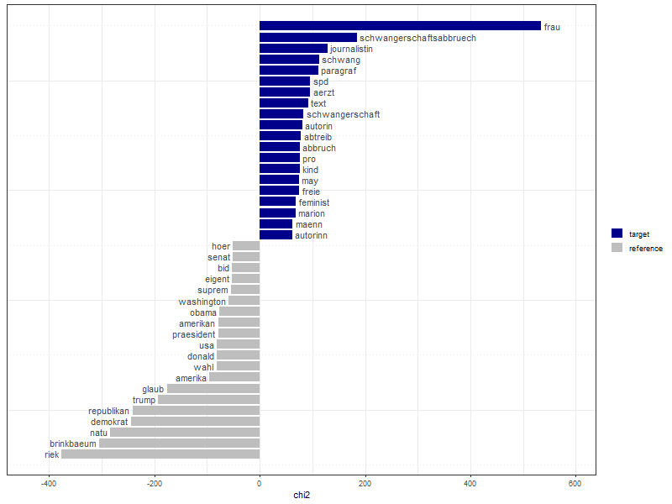
Results Keyness

Slide 5
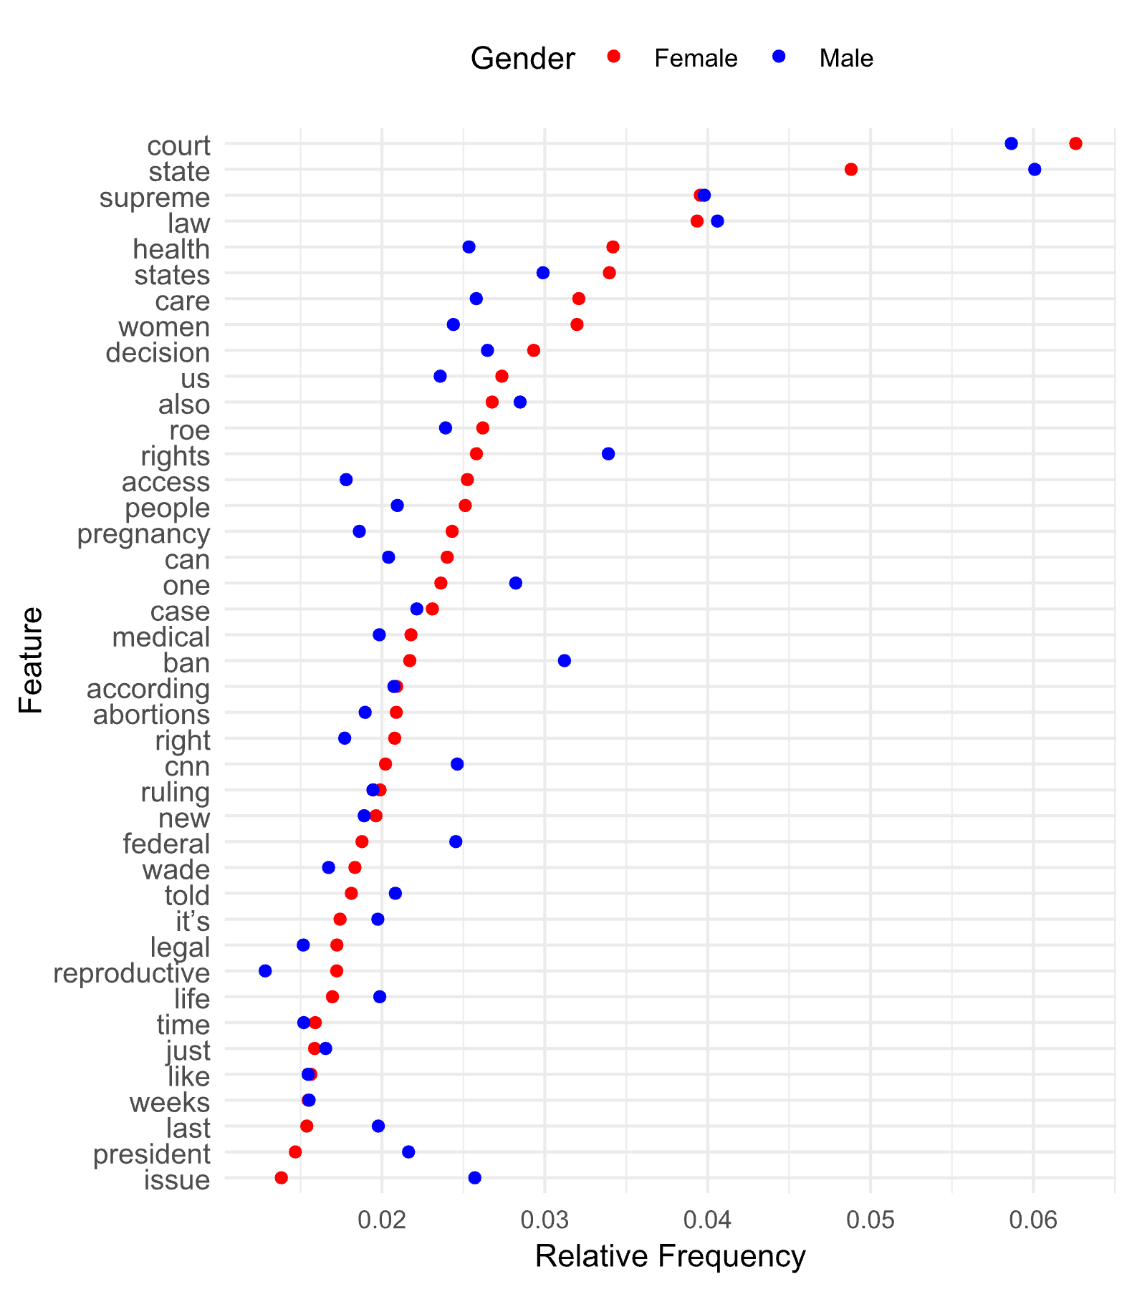
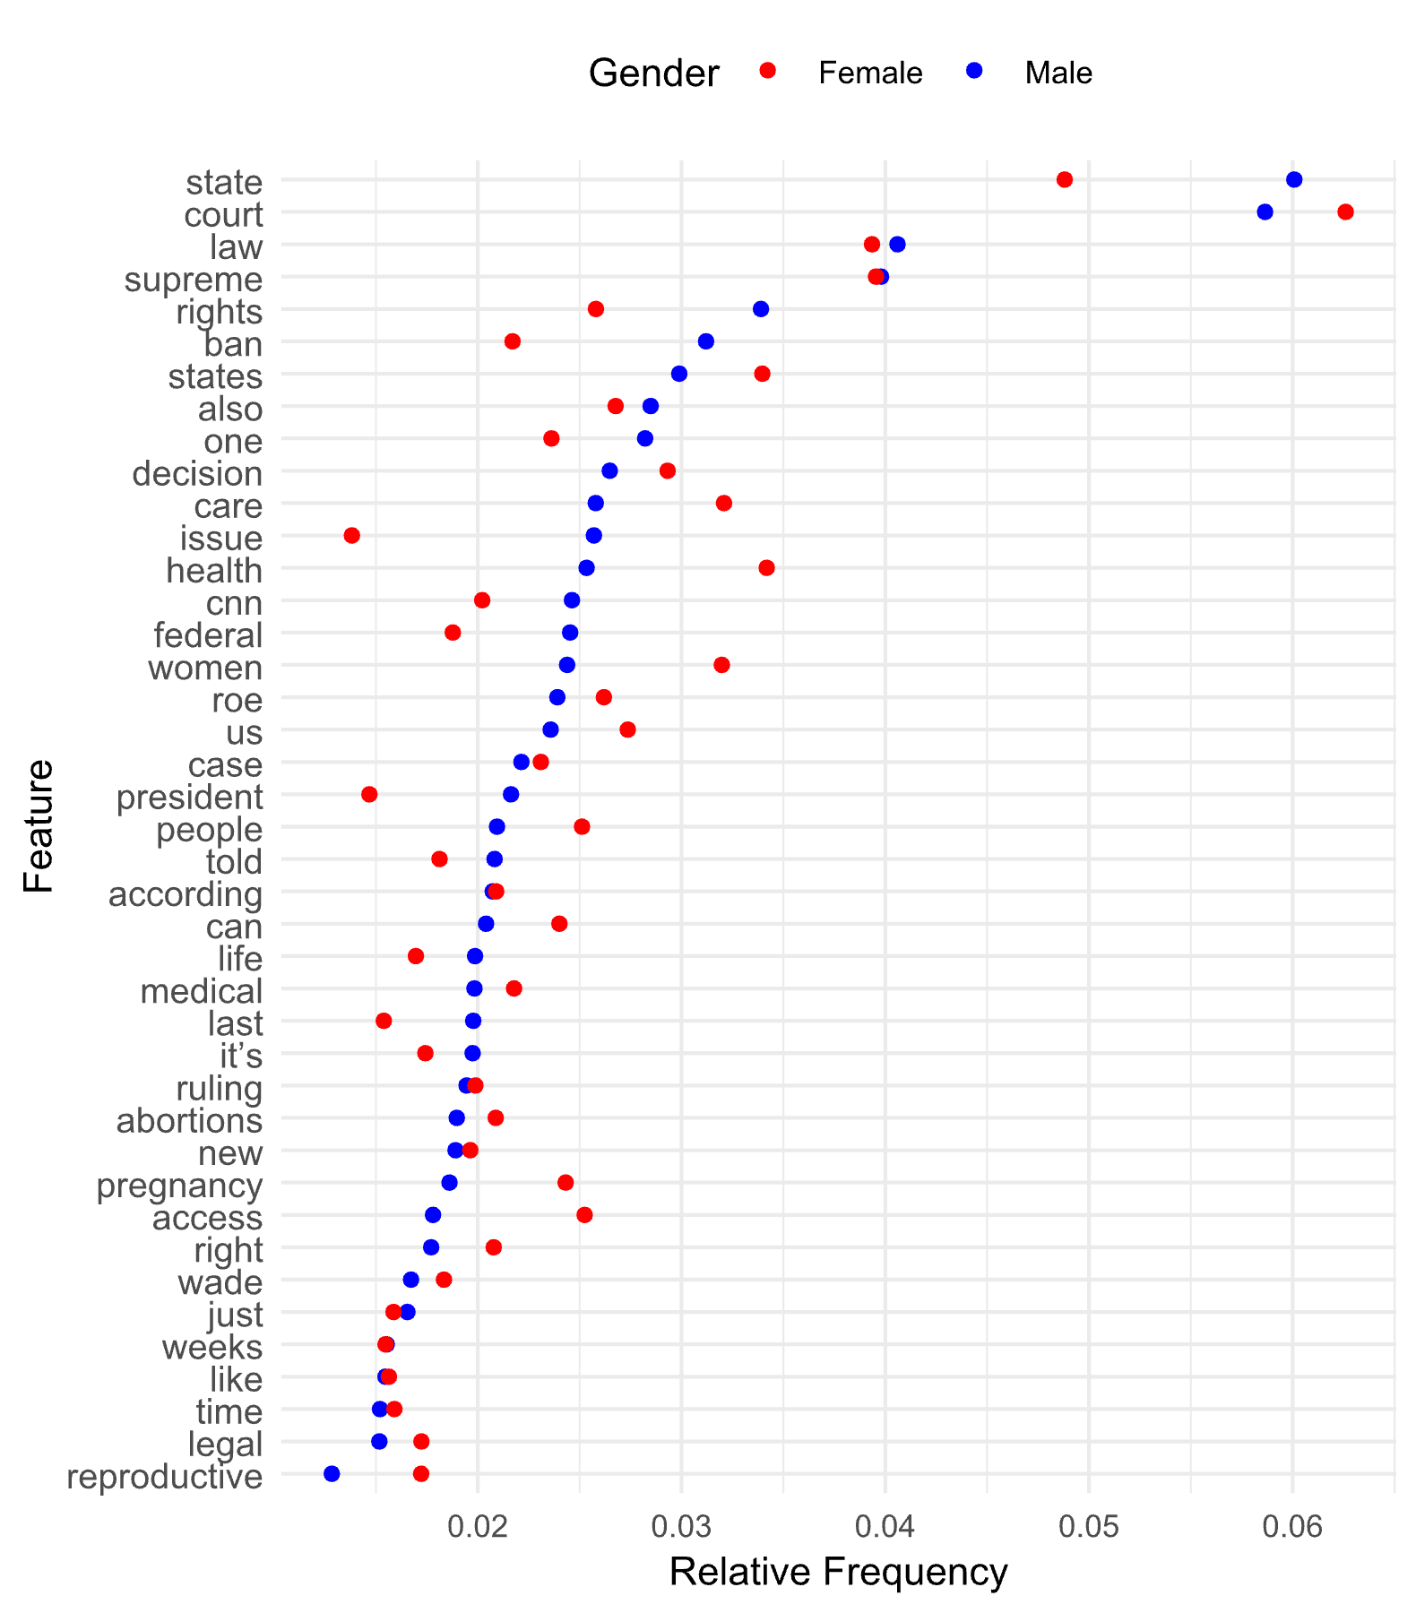
RESULTS GGPLOT

Slide 6
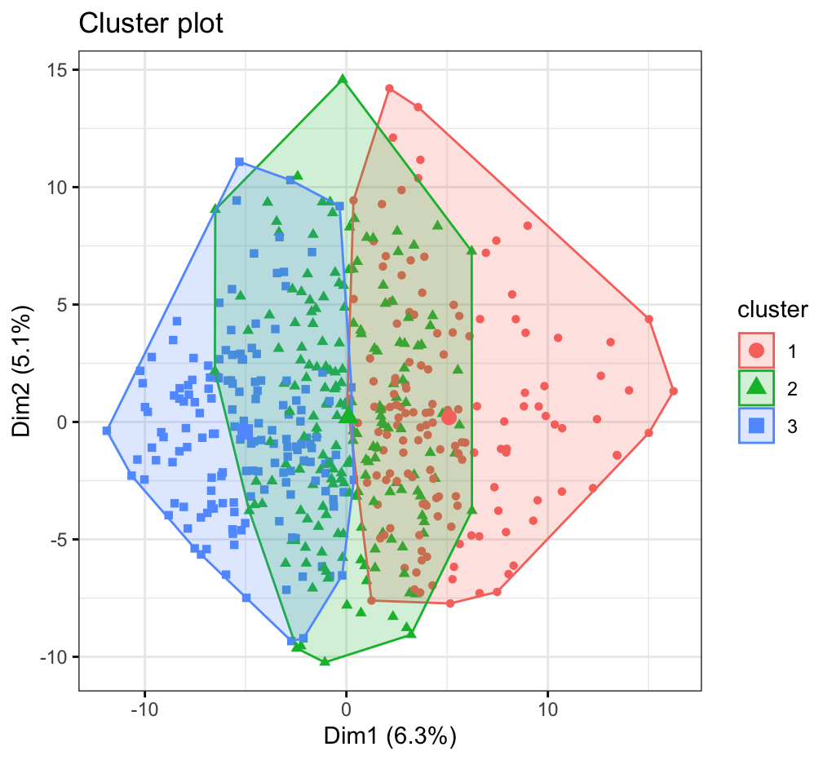
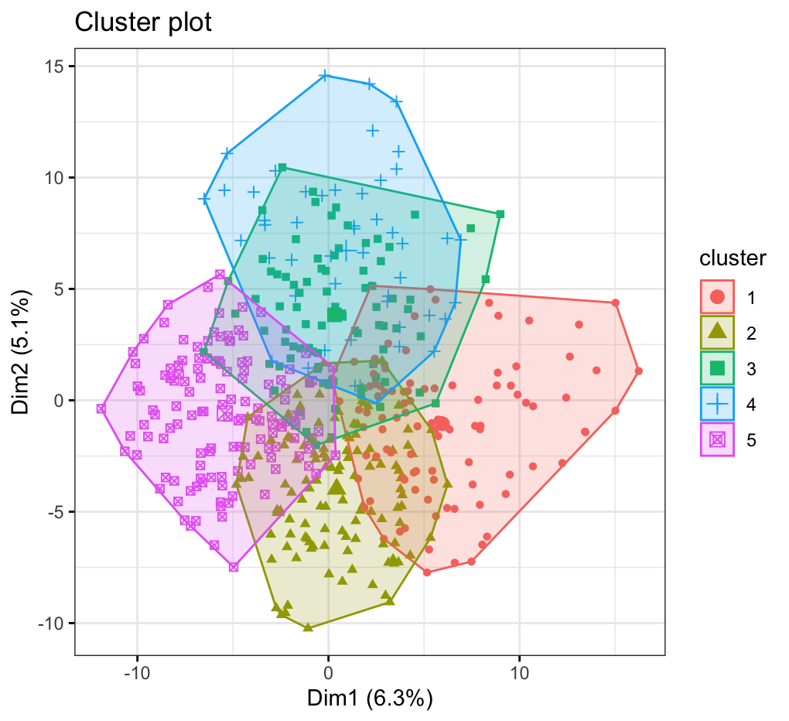
Results Cluster Plot K-Means

Slide 7
Problems you encountered
Scraping websites that use lots of JavaScript (e.g. Fox News, VOX)
Selecting blocks without unique identifiers
Assigning gender to authors with less common names
German language: Many more stopwords in the German language, Umlaut (i.e., ä, ü)
Making sense of features and adjusting stopwords
Lots of time spent on plot output and saving

Slide 8
Learnings for next time
Collaborate in one code document?
Unify dataset early on
Make plot output process more efficient

